Slide 1
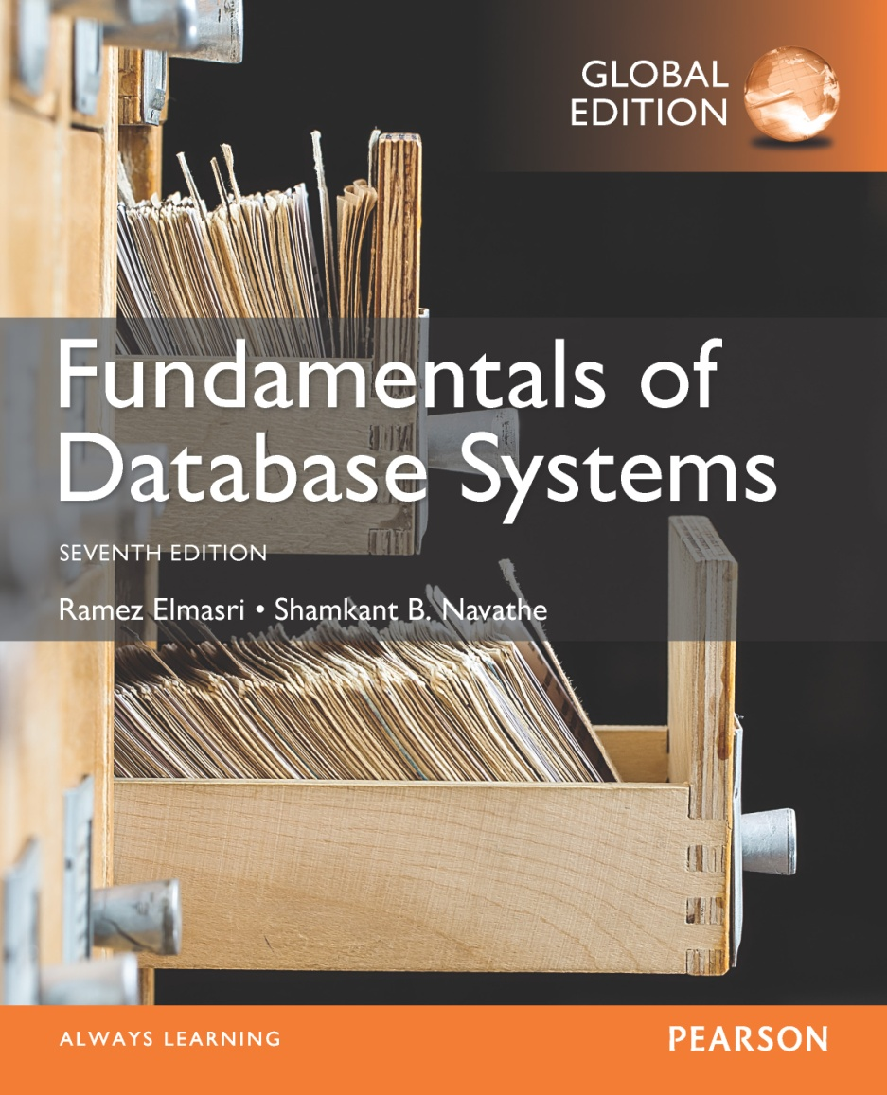

Slide 2
CHAPTER 7
More SQL: Complex Queries, Triggers, Views, and Schema Modification
Slide 7- <number>

Slide 3
Chapter 7 Outline
More Complex SQL Retrieval Queries
Specifying Semantic Constraints as Assertions and Actions as Triggers
Views (Virtual Tables) in SQL
Schema Modification in SQL
Slide 7- 3

Slide 4
More Complex SQL Retrieval Queries
Additional features allow users to specify more complex retrievals from database:
  Nested queries, joined tables, and outer joins (in the FROM clause), aggregate functions, and grouping
Slide 7- 4

Slide 5
Comparisons Involving NULL and Three-Valued Logic
Meanings of NULL
  Unknown value
  Unavailable or withheld value
  Not applicable attribute
Each individual NULL value considered to be different from every other NULL value
SQL uses a three-valued logic:
  TRUE, FALSE, and UNKNOWN (like Maybe)
NULL = NULL comparison is avoided
Slide 7- 5

Slide 6
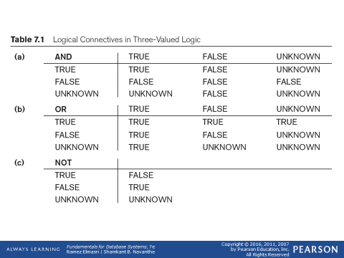
Comparisons Involving NULL and Three-Valued Logic (cont’d.)
Slide 7- 6

Slide 7

Comparisons Involving NULL and Three-Valued Logic (cont’d.)
SQL allows queries that check whether an attribute value is NULL
  IS or IS NOT NULL
Slide 7- 7

Slide 8
Nested Queries, Tuples, and Set/Multiset Comparisons
Nested queries
  Complete select-from-where blocks within WHERE clause of another query
  Outer query and nested subqueries
Comparison operator IN
  Compares value v with a set (or multiset) of values V
  Evaluates to TRUE if v is one of the elements in V
Slide 7- 8

Slide 9
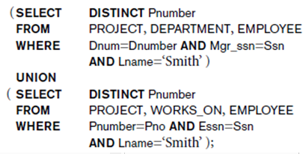


Nested Queries (cont’d.)
Slide 7- 9

Slide 10

Nested Queries (cont’d.)
Use tuples of values in comparisons
  Place them within parentheses
Slide 7- 10

Slide 11

Nested Queries (cont’d.)
Use other comparison operators to compare a single value v
  = ANY (or = SOME) operator
    Returns TRUE if the value v is equal to some value in the set V and is hence equivalent to IN
  Other operators that can be combined with ANY (or SOME): >, >=, <, <=, and <>
  ALL: value must exceed all values from nested query
Slide 7- 11

Slide 12

Nested Queries (cont’d.)
Avoid potential errors and ambiguities
  Create tuple variables (aliases) for all tables referenced in SQL query
Slide 7- <number>

Slide 13
Correlated Nested Queries
Queries that are nested using the = or IN comparison operator can be collapsed into one single block: E.g., Q16 can be written as:
Q16A: SELECT E.Fname, E.Lname
FROM EMPLOYEE AS E, DEPENDENT AS D
WHERE E.Ssn=D.Essn AND E.Sex=D.Sex
AND E.Fname=D.Dependent_name;
Correlated nested query
  Evaluated once for each tuple in the outer query
Slide 7- 13

Slide 14
The EXISTS and UNIQUE Functions in SQL for correlating queries
EXISTS function
  Check whether the result of a correlated nested query is empty or not. They are Boolean functions that return a TRUE or FALSE result.
EXISTS and NOT EXISTS
  Typically used in conjunction with a correlated nested query
SQL function UNIQUE(Q)
  Returns TRUE if there are no duplicate tuples in the result of query Q
Slide 7- 14

Slide 15
USE of EXISTS
Q7: List the names of managers who have atleast one dependent
SELECT Fname, Lname
FROM Employee
WHERE EXISTS (SELECT *
FROM DEPENDENT
WHERE Ssn= Essn)
AND EXISTS (SELECT *
FROM Department
WHERE Ssn= Mgr_Ssn)
Slide 7- 15

Slide 16

Explicit Sets and Renaming of Attributes in SQL
Can use explicit set of values in WHERE clause
Q17: SELECT DISTINCT Essn
FROM WORKS_ON
WHERE Pno IN (1, 2, 3);
Use qualifier AS followed by desired new name
  Rename any attribute that appears in the result of a query
Slide 7- 18

Slide 17

Specifying Joined Tables in the FROM Clause of SQL
Joined table
  Permits users to specify a table resulting from a join operation in the FROM clause of a query
The FROM clause in Q1A
  Contains a single joined table. JOIN may also be called INNER JOIN
Slide 7- 19

Slide 18
Different Types of JOINed Tables in SQL
Specify different types of join
  NATURAL JOIN
  Various types of OUTER JOIN (LEFT, RIGHT, FULL )
NATURAL JOIN on two relations R and S
  No join condition specified
  Is equivalent to an implicit EQUIJOIN condition for each pair of attributes with same name from R and S
Slide 7- 20

Slide 19
NATURAL JOIN
Rename attributes of one relation so it can be joined with another using NATURAL JOIN:
Q1B: SELECT Fname, Lname, Address
FROM (EMPLOYEE NATURAL JOIN
(DEPARTMENT AS DEPT (Dname, Dno, Mssn,
Msdate)))
WHERE Dname=‘Research’;
The above works with EMPLOYEE.Dno = DEPT.Dno as an implicit join condition
Slide 7- <number>

Slide 20
INNER and OUTER Joins
INNER JOIN (versus OUTER JOIN)
  Default type of join in a joined table
  Tuple is included in the result only if a matching tuple exists in the other relation
LEFT OUTER JOIN
  Every tuple in left table must appear in result
  If no matching tuple
    Padded with NULL values for attributes of right table
RIGHT OUTER JOIN
  Every tuple in right table must appear in result
  If no matching tuple
    Padded with NULL values for attributes of left table
Slide 7- 22

Slide 21

Example: LEFT OUTER JOIN
SELECT E.Lname AS Employee_Name
S.Lname AS Supervisor_Name
FROM Employee AS E LEFT OUTER JOIN EMPLOYEE AS S
ON E.Super_ssn = S.Ssn)
ALTERNATE SYNTAX:
SELECT E.Lname , S.Lname
FROM EMPLOYEE E, EMPLOYEE S
WHERE E.Super_ssn + = S.Ssn
Slide 7- <number>

Slide 22
Multiway JOIN in the FROM clause
FULL OUTER JOIN – combines result if LEFT and RIGHT OUTER JOIN
Can nest JOIN specifications for a multiway join:
Q2A: SELECT Pnumber, Dnum, Lname, Address, Bdate
FROM ((PROJECT JOIN DEPARTMENT ON Dnum=Dnumber) JOIN EMPLOYEE ON Mgr_ssn=Ssn)
WHERE Plocation=‘Stafford’;
Slide 7- <number>

Slide 23
Aggregate Functions in SQL
Used to summarize information from multiple tuples into a single-tuple summary
Built-in aggregate functions
  COUNT, SUM, MAX, MIN, and AVG
Grouping
  Create subgroups of tuples before summarizing
To select entire groups, HAVING clause is used
Aggregate functions can be used in the SELECT clause or in a HAVING clause
Slide 7- <number>

Slide 24
Renaming Results of Aggregation
Following query returns a single row of computed values from EMPLOYEE table:
Q19: SELECT SUM (Salary), MAX (Salary), MIN (Salary), AVG (Salary)
FROM EMPLOYEE;
The result can be presented with new names:
Q19A: SELECT SUM (Salary) AS Total_Sal, MAX (Salary) AS Highest_Sal, MIN (Salary) AS Lowest_Sal, AVG (Salary) AS Average_Sal
FROM EMPLOYEE;
Slide 7- <number>

Slide 25

Aggregate Functions in SQL (cont’d.)
NULL values are discarded when aggregate functions are applied to a particular column
Slide 7- <number>

Slide 26
Aggregate Functions on Booleans
SOME and ALL may be applied as functions on Boolean Values.
SOME returns true if at least one element in the collection is TRUE (similar to OR)
ALL returns true if all of the elements in the collection are TRUE (similar to AND)
Slide 7- <number>

Slide 27
Grouping: The GROUP BY Clause
Partition relation into subsets of tuples
  Based on grouping attribute(s)
  Apply function to each such group independently
GROUP BY clause
  Specifies grouping attributes
COUNT (*) counts the number of rows in the group
Slide 7- <number>

Slide 28
Examples of GROUP BY
The grouping attribute must appear in the SELECT clause:
Q24: SELECT Dno, COUNT (*), AVG (Salary)
FROM EMPLOYEE
GROUP BY Dno;
If the grouping attribute has NULL as a possible value, then a separate group is created for the null value (e.g., null Dno in the above query)
GROUP BY may be applied to the result of a JOIN:
Q25: SELECT Pnumber, Pname, COUNT (*)
FROM PROJECT, WORKS_ON
WHERE Pnumber=Pno
GROUP BY Pnumber, Pname;
Slide 7- <number>

Slide 29
Grouping: The GROUP BY and HAVING Clauses (cont’d.)
HAVING clause
  Provides a condition to select or reject an entire group:
Query 26. For each project on which more than two employees work, retrieve the project number, the project name, and the number of employees who work on the project.
Q26: SELECT Pnumber, Pname, COUNT (*)
FROM PROJECT, WORKS_ON
WHERE Pnumber=Pno
GROUP BY Pnumber, Pname
HAVING COUNT (*) > 2;
Slide 7- 31

Slide 30
Use of WITH
The WITH clause allows a user to define a table that will only be used in a particular query (not available in all SQL implementations)
Used for convenience to create a temporary “View” and use that immediately in a query
Allows a more straightforward way of looking a step-by-step query
Slide 7- <number>

Slide 31
Example of WITH
See an alternate approach to doing Q28:
Q28’: WITH BIGDEPTS (Dno) AS
( SELECT Dno
FROM EMPLOYEE
GROUP BY Dno
HAVING COUNT (*) > 5)
SELECT Dno, COUNT (*)
FROM EMPLOYEE
WHERE Salary>40000 AND Dno IN BIGDEPTS
GROUP BY Dno;
Slide 7- <number>

Slide 32
Use of CASE
SQL also has a CASE construct
Used when a value can be different based on certain conditions.
Can be used in any part of an SQL query where a value is expected
Applicable when querying, inserting or updating tuples
Slide 7- <number>

Slide 33
EXAMPLE of use of CASE
The following example shows that employees are receiving different raises in different departments (A variation of the update U6)
U6’: UPDATE EMPLOYEE
SET Salary =
CASE WHEN Dno = 5 THEN Salary + 2000
WHEN Dno = 4 THEN Salary + 1500
WHEN Dno = 1 THEN Salary + 3000
Slide 7- <number>

Slide 34
Recursive Queries in SQL
An example of a recursive relationship between tuples of the same type is the relationship between an employee and a supervisor.
This relationship is described by the foreign key Super_ssn of the EMPLOYEE relation
An example of a recursive operation is to retrieve all supervisees of a supervisory employee e at all levels—that is, all employees e′ directly supervised by e, all employees e′’ directly supervised by each employee e′, all employees e″′ directly supervised by each employee e″, and so on. Thus the CEO would have each employee in the company as a supervisee in the resulting table. Example shows such table SUP_EMP with 2 columns (Supervisor,Supervisee(any level)):
Slide 7- <number>

Slide 35
An EXAMPLE of RECURSIVE Query
Q29: WITH RECURSIVE SUP_EMP (SupSsn, EmpSsn) AS
SELECT SupervisorSsn, Ssn
FROM EMPLOYEE
UNION
SELECT E.Ssn, S.SupSsn
FROM EMPLOYEE AS E, SUP_EMP AS S
WHERE E.SupervisorSsn = S.EmpSsn)
SELECT *
FROM SUP_EMP;
The above query starts with an empty SUP_EMP and successively builds SUP_EMP table by computing immediate supervisees first, then second level supervisees, etc. until a fixed point is reached and no more supervisees can be added
Slide 7- <number>

Slide 36

EXPANDED Block Structure of SQL Queries
Slide 7- 40

Slide 37
Specifying Constraints as Assertions and Actions as Triggers
Semantic Constraints: The following are beyond the scope of the EER and relational model
CREATE ASSERTION
  Specify additional types of constraints outside scope of built-in relational model constraints
CREATE TRIGGER
  Specify automatic actions that database system will perform when certain events and conditions occur
Slide 7- 41

Slide 38

Specifying General Constraints as Assertions in SQL
CREATE ASSERTION
  Specify a query that selects any tuples that violate the desired condition
  Use only in cases where it goes beyond a simple CHECK which applies to individual attributes and domains
Slide 7- <number>

Slide 39
Introduction to Triggers in SQL
CREATE TRIGGER statement
  Used to monitor the database
Typical trigger has three components which make it a rule for an “active database “ (more on active databases in section 26.1) :
  Event(s)
  Condition
  Action
Slide 7- 43

Slide 40
USE OF TRIGGERS
AN EXAMPLE with standard Syntax.(Note : other SQL implementations like PostgreSQL use a different syntax.)
R5:
CREATE TRIGGER SALARY_VIOLATION
BEFORE INSERT OR UPDATE OF Salary, Supervisor_ssn ON EMPLOYEE
FOR EACH ROW
WHEN (NEW.SALARY > ( SELECT Salary FROM EMPLOYEE
WHERE Ssn = NEW. Supervisor_Ssn)) INFORM_SUPERVISOR (NEW.Supervisor.Ssn, New.Ssn)
Slide 7- 44

Slide 41
Views (Virtual Tables) in SQL
Concept of a view in SQL
  Single table derived from other tables called the defining tables
  Considered to be a virtual table that is not necessarily populated
Slide 7- 45

Slide 42

Specification of Views in SQL
CREATE VIEW command
  Give table name, list of attribute names, and a query to specify the contents of the view
  In V1, attributes retain the names from base tables. In V2, attributes are assigned names
Slide 7- 46

Slide 43
Specification of Views in SQL (cont’d.)
Once a View is defined, SQL queries can use the View relation in the FROM clause
View is always up-to-date
  Responsibility of the DBMS and not the user
DROP VIEW command
  Dispose of a view
Slide 7- 47

Slide 44
View Implementation, View Update, and Inline Views
Complex problem of efficiently implementing a view for querying
Strategy1: Query modification approach
  Compute the view as and when needed. Do not store permanently
  Modify view query into a query on underlying base tables
  Disadvantage: inefficient for views defined via complex queries that are time-consuming to execute
Slide 7- 48

Slide 45
View Materialization
Strategy 2: View materialization
  Physically create a temporary view table when the view is first queried
  Keep that table on the assumption that other queries on the view will follow
  Requires efficient strategy for automatically updating the view table when the base tables are updated
Incremental update strategy for materialized views
  DBMS determines what new tuples must be inserted, deleted, or modified in a materialized view table
Slide 7- 49

Slide 46
View Update
Update on a view defined on a single table without any aggregate functions
  Can be mapped to an update on underlying base table- possible if the primary key is preserved in the view
Update not permitted on aggregate views. E.g.,
UV2: UPDATE DEPT_INFO
SET Total_sal=100000
WHERE Dname=‘Research’;
cannot be processed because Total_sal is a computed value in the view definition
Slide 7- 51

Slide 47
Views as authorization mechanism
SQL query authorization statements (GRANT and REVOKE) are described in detail in Chapter 30
Views can be used to hide certain attributes or tuples from unauthorized users
E.g., For a user who is only allowed to see employee information for those who work for department 5, he may only access the view DEPT5EMP:
  CREATE VIEW DEPT5EMP AS
  SELECT *
  FROM EMPLOYEE
  WHERE Dno = 5;
Slide 7- <number>

Slide 48
Schema Change Statements in SQL
Schema evolution commands
  DBA may want to change the schema while the database is operational
  Does not require recompilation of the database schema
Slide 7- 54

Slide 49
The DROP Command
DROP command
  Used to drop named schema elements, such as tables, domains, or constraint
Drop behavior options:
  CASCADE and RESTRICT
Example:
  DROP SCHEMA COMPANY CASCADE;
  This removes the schema and all its elements including tables,views, constraints, etc.
Slide 7- 55

Slide 50
The ALTER table command
Alter table actions include:
  Adding or dropping a column (attribute)
  Changing a column definition
  Adding or dropping table constraints
Example:
  ALTER TABLE COMPANY.EMPLOYEE ADD COLUMN Job VARCHAR(12);
Slide 7- 56

Slide 51

Adding and Dropping Constraints
Change constraints specified on a table
  Add or drop a named constraint
Slide 7- 57

Slide 52
Dropping Columns, Default Values
To drop a column
  Choose either CASCADE or RESTRICT
  CASCADE would drop the column from views etc. RESTRICT is possible if no views refer to it.
ALTER TABLE COMPANY.EMPLOYEE DROP COLUMN Address CASCADE;
Default values can be dropped and altered :
  ALTER TABLE COMPANY.DEPARTMENT ALTER COLUMN Mgr_ssn DROP DEFAULT;
  ALTER TABLE COMPANY.DEPARTMENT ALTER COLUMN Mgr_ssn SET DEFAULT ‘333445555’;
Slide 7- <number>

Slide 53
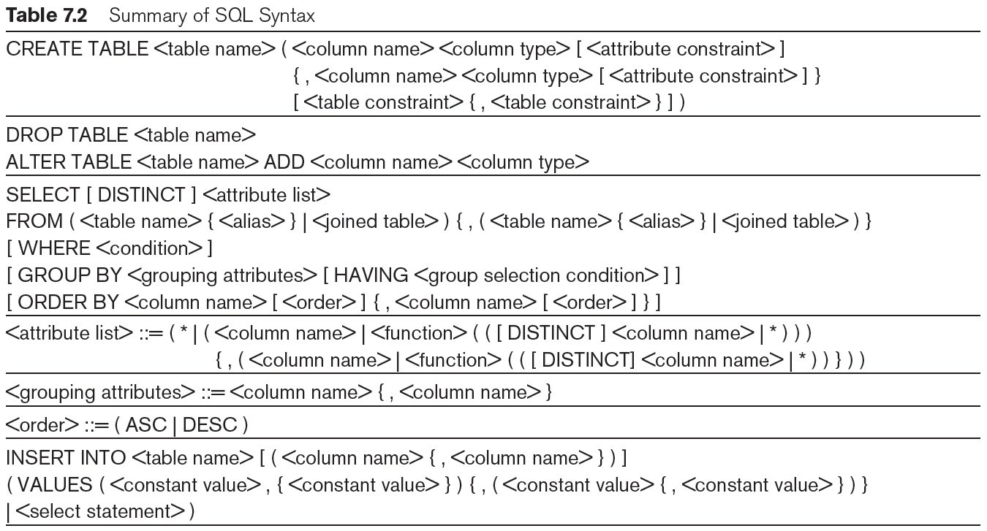
Table 7.2 Summary of SQL Syntax
continued on next slide
Slide 7- 59

Slide 54
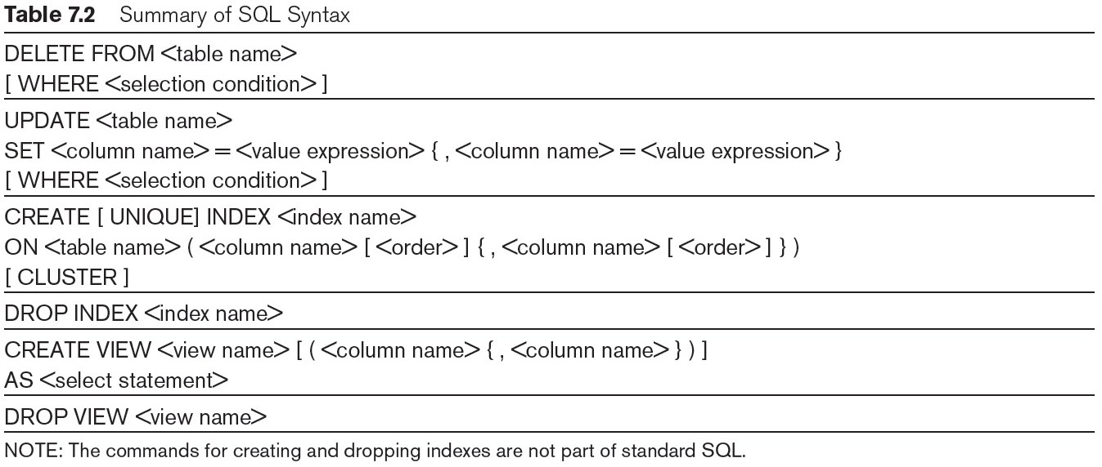
Table 7.2 (continued) Summary of SQL Syntax
Slide 7- 60

